Slide 1
Need for multiplexing
Capacity of transmission medium usually exceeds capacity required for transmission of a single signal
If the bandwidth of a link is greater than the bandwidth needs of the devices connected to it, the bandwidth is wasted
So a medium linking two devices can be shared whenever the bandwidth of the medium is greater than the bandwidth needs of the devices

Slide 2
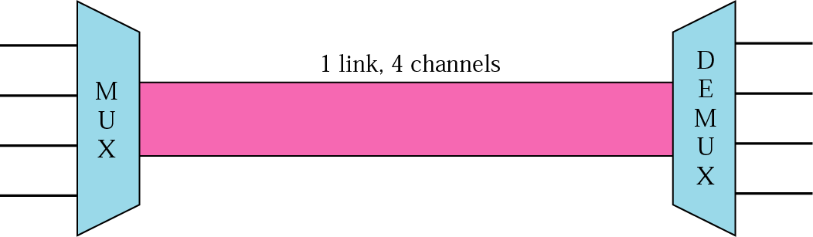
Dividing a link into Channels
Multiplexing is a set of techniques that allows the simultaneous transmission of multiple signals across a single data link.
Multiplexer (MUX) combines multiple streams into a single stream (many to one) and transmits over higher capacity data link
Demultiplexer (DEMUX) separates the stream back into its component transmission (one to many) and directs them to their correct lines.

Slide 3
Multiplexing (Combining)
n inputs to a multiplexer
a single data link
connects multiplexer and de-multiplexer
able to carry n separate channels of data
used to reduce the number of transmission media needed between cities and towns (to share an expensive resource)
Remember: Channel refers to the portion of a link that carries a transmission between a given pair of lines. One link can have many (n) channels

Slide 4
According to the Encyclopedia of Networking & Telecommunications
Multiplexing combines multiple channels of information over a single circuit or transmission path

Slide 5
In electronics
multiplexing allows several analog signals to be processed by one analog-to-digital converter (ADC)
In telecommunications
Several phone calls may be transferred using one wire
In communications
the multiplexed signal is transmitted over a communication channel, which may be a physical transmission medium

Slide 6
Types of Multiplexing
Frequency-Division Multiplexing(FDM),
Wavelength-Division Multiplexing (WDM)
Time-Division Multiplexing(TDM)
Code-Division Multiplexing(CDM)

Slide 7
Frequency-division multiplexing (FDM)
A technique by which the total bandwidth available in a communication medium is divided into a series of non-overlapping frequency sub-bands,
each of which is used to carry a separate signal
Each signal is assigned a different frequency (sub-band) within the main channel
It takes advantage of the fact that the useful bandwidth of the medium exceeds the required bandwidth of a given signal

Slide 8
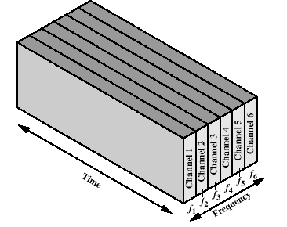
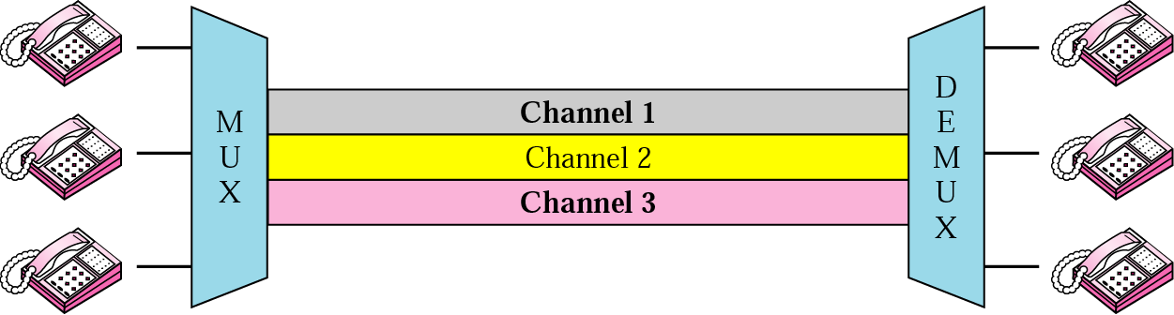
Frequency-division multiplexing (FDM)
Channels can be separated by strips of unused bandwidth guard bands to prevent signals from overlapping

Slide 9
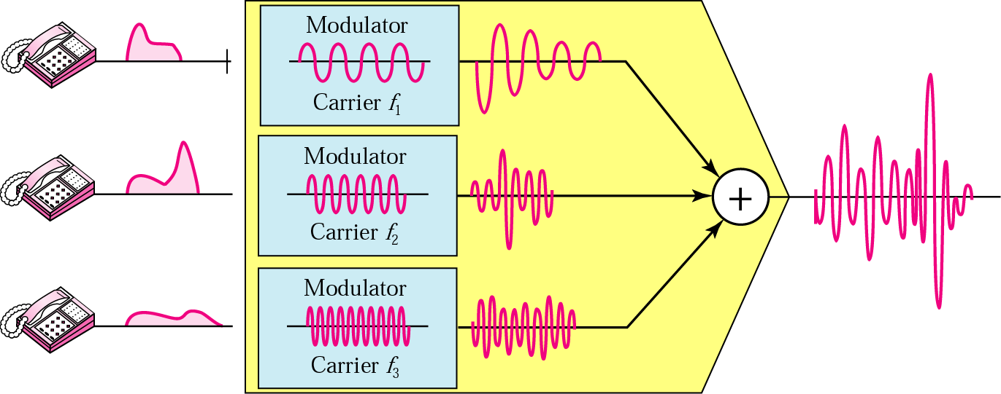
Multiplexing process
a conceptual illustration of the multiplexing process (figure)
Each source generates a signal of a similar frequency range
Inside the multiplexer, these similar signals are modulated onto different carrier frequencies (f₁,f₂ and f₃)
The resulting modulated signals are then combined into a single composite signal that is sent out over a media link
The link should have enough bandwidth to accommodate it

Slide 10
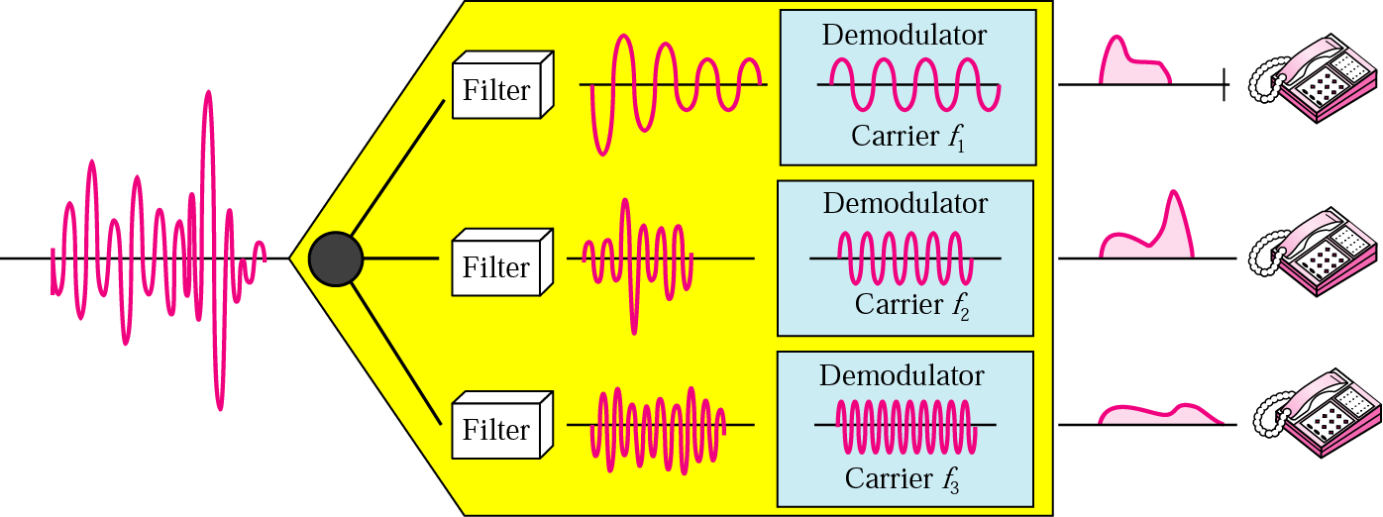
De-multiplexing process
The de-multiplexer uses a series of filters to decompose the multiplexed signal into its constituent component signals
The individual signals are then passed to a demodulator that separates them from their carriers and passes them to the waiting receivers (output lines)

Slide 11
FDM: Applications
Radio and television broadcasting
multiple radio signals at different frequencies pass through the air at the same time
Cable television
many television channels are carried simultaneously on a single cable
Telephone systems
to transmit multiple telephone calls through high capacity lines

Slide 12
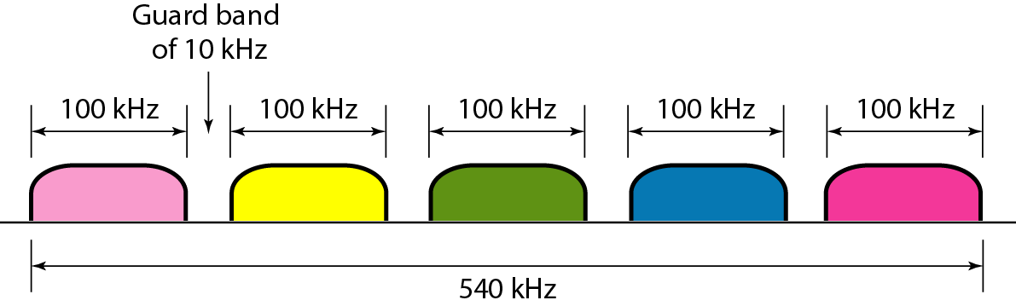
Examples
Five channels, each with a 100-kHz bandwidth, are to be multiplexed together. What is the minimum bandwidth of the link provided there is a guard band of 10 kHz between the channels to prevent interference?
For five channels, guard bands needed = 4
So required bandwidth is at least = 5 x 100 + 4 x 10 =540 kHz

Slide 13
Examples
Assume that a voice channel occupies a bandwidth of 4 kHz. We need to combine three voice channels into a link with a bandwidth of 12 kHz, from 20 to 32 kHz. Show the configuration, using the frequency domain. Assume there are no guard bands.
Solution
We shift (modulate) each of the three voice channels to a different bandwidth, then
We use the 20- to 24-kHz bandwidth for the first channel, the 24- to 28-kHz bandwidth for the second channel, and the 28- to 32-kHz bandwidth for the third one. Then we combine them as shown in Figure (next slide)

Slide 14
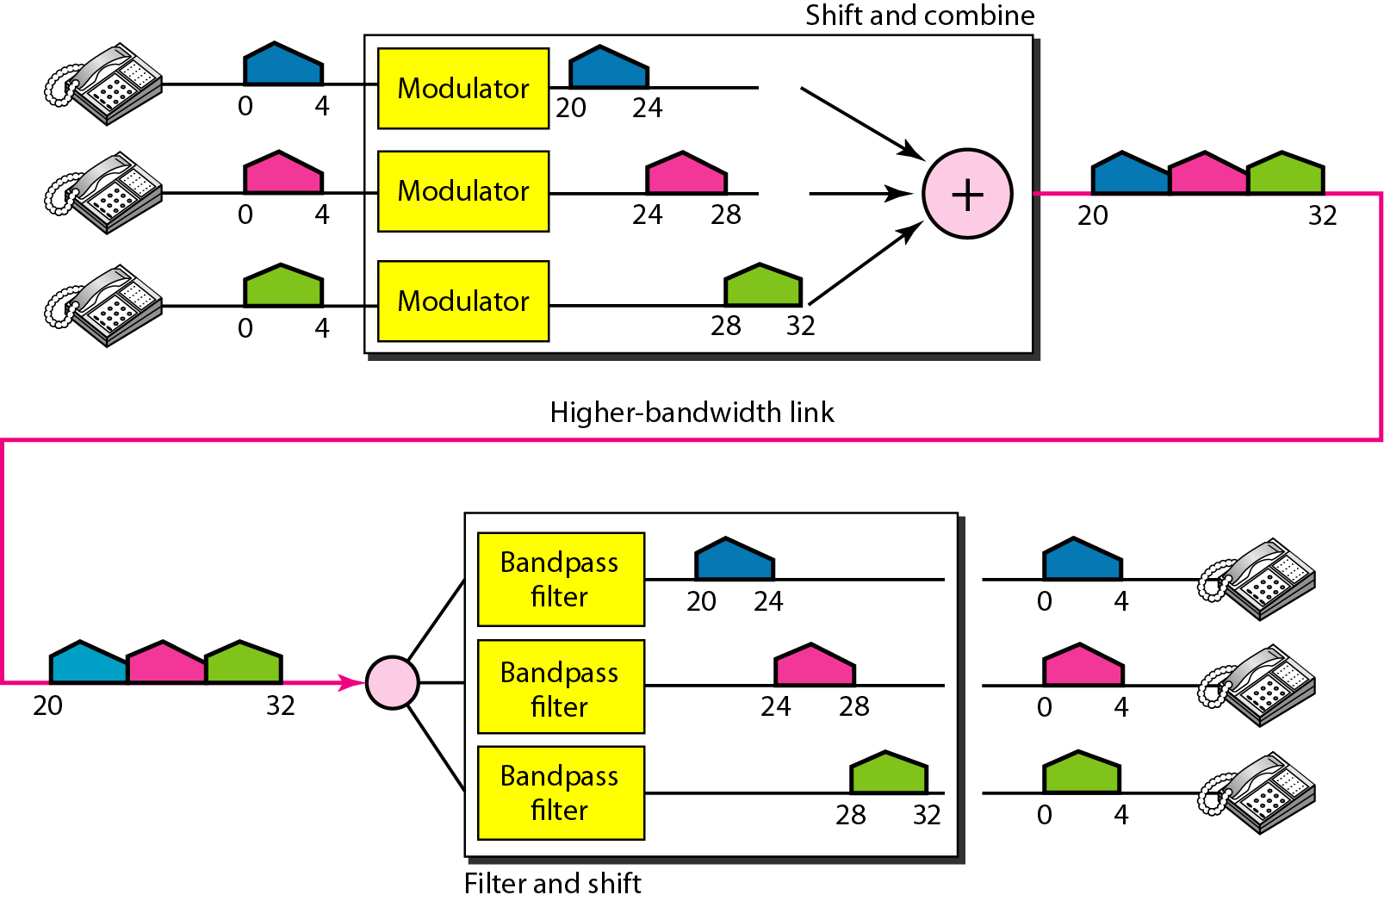
Figure related to previous example

Slide 15
Other Applications of FDM
AM and FM radio broadcasting use air as the transmission medium
A special band from 530 to 1700 kHz is assigned to AM radio
each AM station needs 10kHz of bandwidth
FM has a wider band of 88 to 108 MHz because each station needs a bandwidth of 200 kHz.

Slide 16
Wavelength-division multiplexing (WDM)
Designed to use the high-data-rate capability of fiber-optic cable
Which is higher than the data rate of metallic transmission cable
WDM is conceptually the same as FDM, except that
the multiplexing and de-multiplexing involve optical signals transmitted through fiber-optic channels
The same idea: combining different signals of different frequencies
The difference: the frequencies are very high
WDM is an analog multiplexing technique to combine optical signals

Slide 17
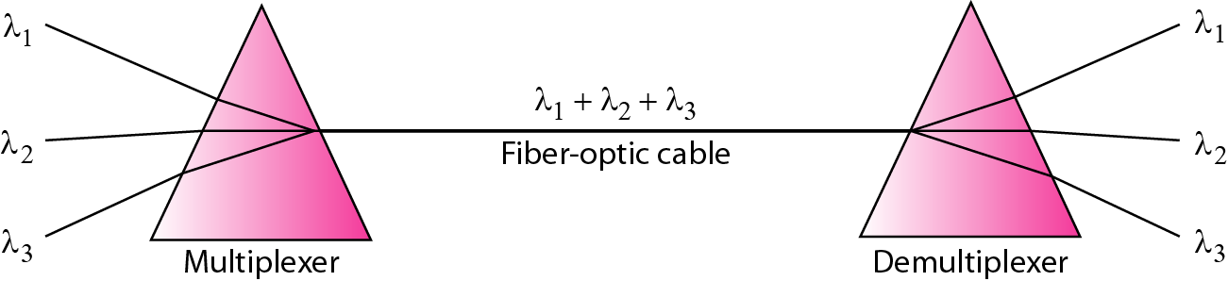
Wavelength-division multiplexing (WDM)
Basic idea: to combine multiple beams of light into one single light at the multiplexer (to make a wider band of light) and do the reverse at the de-multiplexer
Each colour of light (wavelength) carries separate data channel
The combining and splitting of light sources are easily handled by a prism
a prism bends a beam of light based on the angle of incidence and the frequency

Slide 18
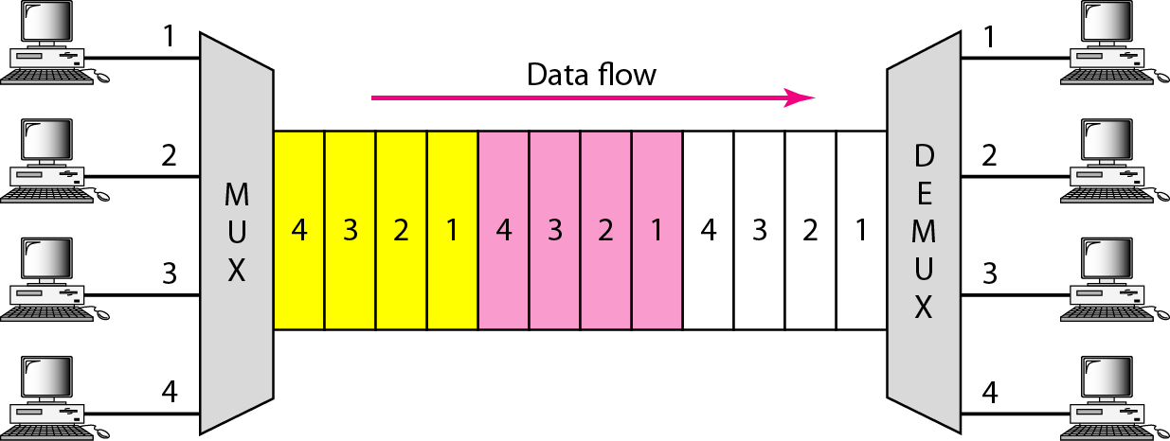
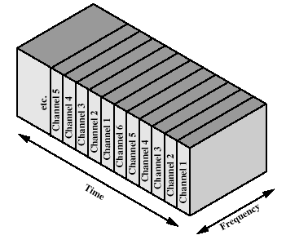
Time-division Multiplexing
TDM is a digital multiplexing technique for combining several low-rate channels into one high-rate one.
In TDM, Instead of sharing a portion of the bandwidth as in FDM, time is shared. Each connection occupies a portion of time in the link.
In the figure, portions of signals 1, 2, 3, and 4 occupy the link sequentially
We can divide TDM into two different schemes: synchronous and statistical

Slide 19
Time-division multiplexing (TDM)
In TDM
each signal appears on the line only a fraction of time in an alternating pattern
Each individual data stream is reassembled at the receiving end based on the timing
TDM takes advantage of the fact that the achievable bit rate of the medium exceeds the required data rate of a digital signal

Slide 20
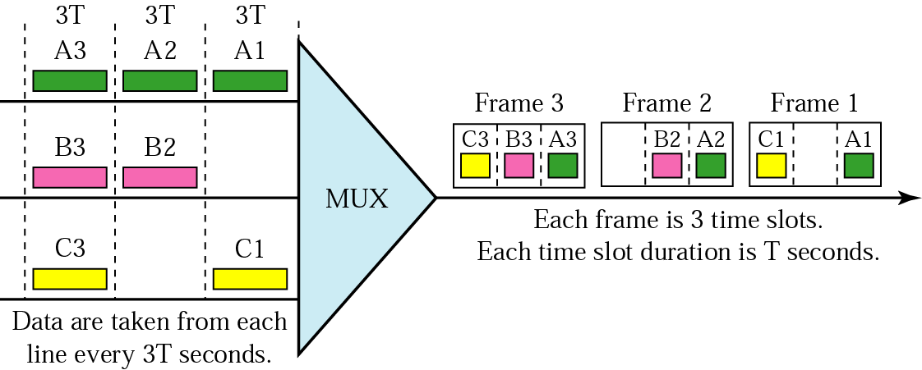
Time-division multiplexing (TDM)
In synchronous TDM,
each input connection has an allotment in the output even if it is not sending data (time slot).
the data rate of the link that carries data from n connections must be n times the data rate of a connection to guarantee the flow of data.

Slide 21
Time Slots and Frames: In synchronous TDM, the data flow of each input connection is divided into units, where each input occupies one input time slot.
A frame consists of one complete cycle of time slots, with one slot dedicated to each sending device

Slide 22
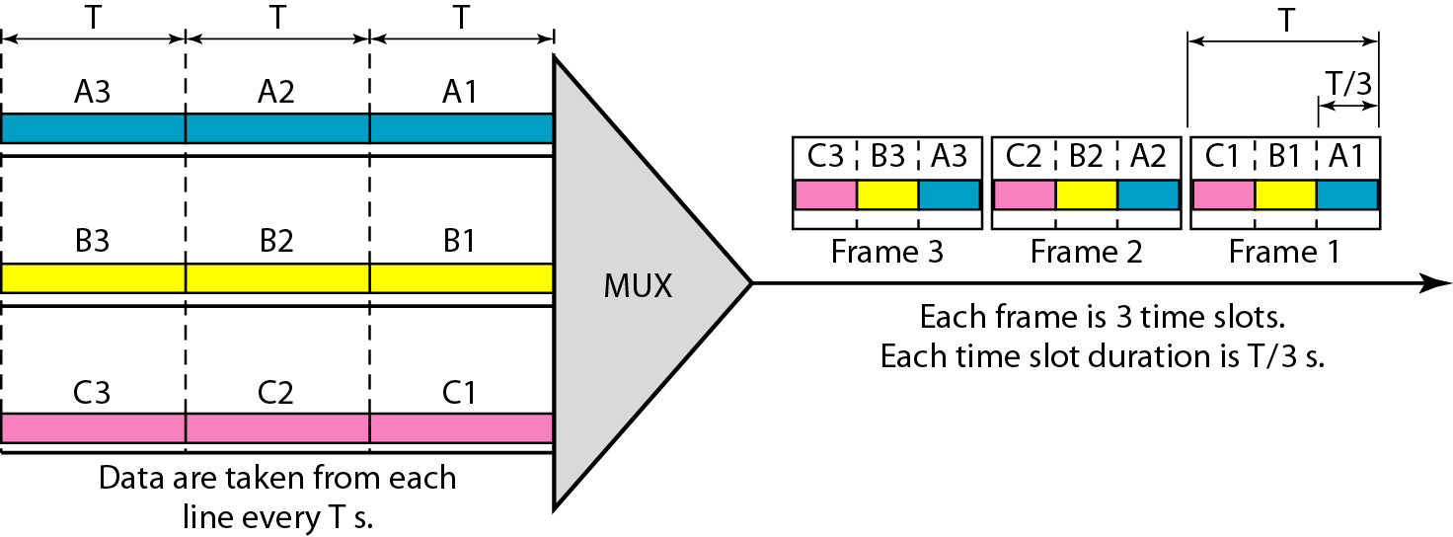
A unit can be 1 bit, one character, or one block of data. Each input unit becomes one output unit and occupies one output time slot.
However, the duration of an output time slot is n times shorter than the duration of an input time slot. If an input time slot is T s, the output time slot is T/n s, where n is the number of connections.
This implies that a unit in the output connection has a shorter duration; it travels faster. The data rate of the link is n times faster, and the unit duration is n times shorter.

Slide 23
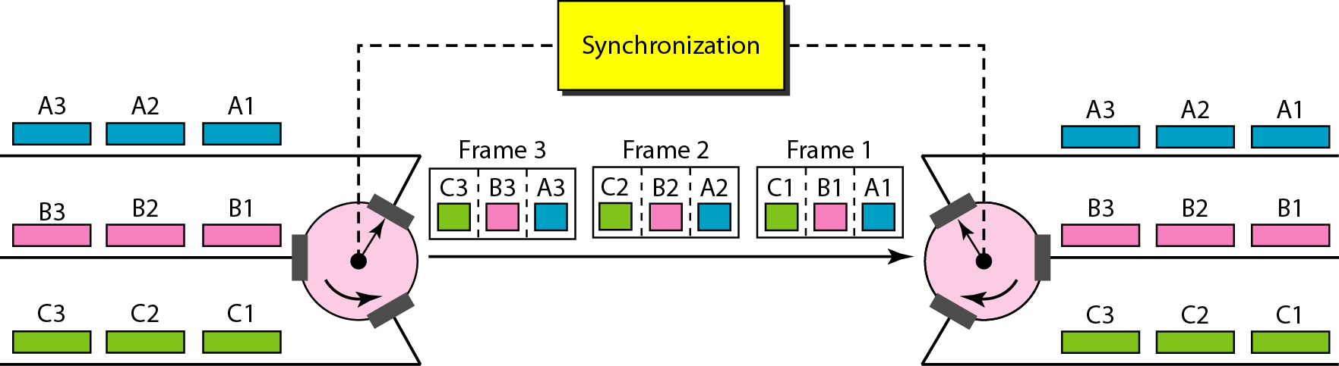
Interleaving
TDM can be visualized as two fast-rotating switches, one on the multiplexing side and the other on the de-multiplexing side.
The switches are synchronized and rotate at the same speed, but in opposite directions.
Multiplexer/De-multiplexer process a terminal/host’s unit in turn.
On the multiplexing side, as the switch opens in front of a connection, that connection has the opportunity to send a unit onto the path. This process is called interleaving.

Slide 24
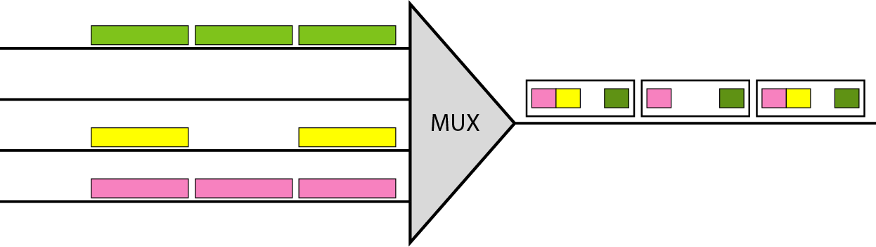
Interleaving
Character (byte) Interleaving: Multiplexing perform one/more character(s) or byte(s) at a time (one byte per unit)
Bit Interleaving: Multiplexing perform on one bit at a time (one bit per unit)
Empty Slots
Synchronous TDM is not as efficient as it could be. If a source does not have data to send, the corresponding slot in the output frame is empty

Slide 25
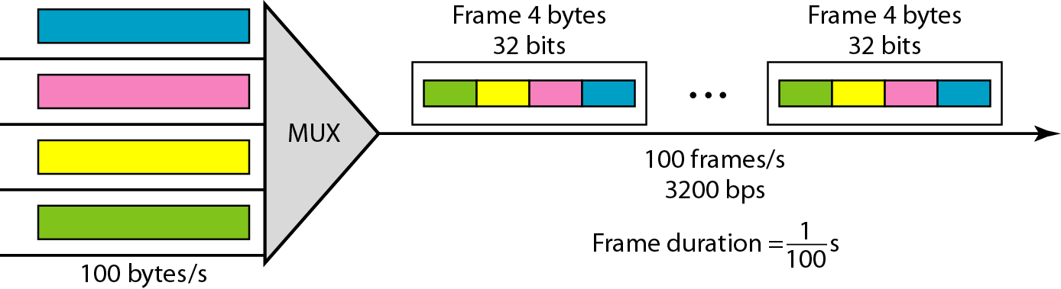
Example
Four channels are multiplexed using TDM. If each channel sends 100 bytes /s and we multiplex 1 byte per channel, show the frame traveling on the link, the size of the frame, the duration of a frame, the frame rate, and the bit rate for the link.
Solution
Each frame carries 1 byte from each channel; the size of each frame, therefore, is 4 bytes, or 32 bits. Because each channel is sending 100 bytes/s and a frame carries 1 byte from each channel, the frame rate must be 100 frames per second. The bit rate is 100 × 32, or 3200 bps.

Slide 26
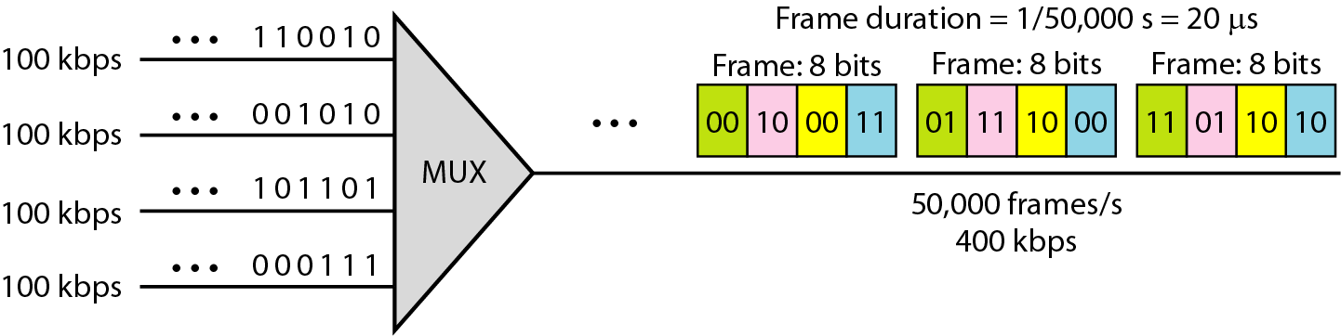
Example
A multiplexer combines four 100-kbps channels using a time slot of 2 bits. Show the output with four arbitrary inputs. What is the frame rate? What is the frame duration? What is the bit rate? What is the bit duration?
Solution
The link carries 50,000 frames per second. The frame duration is therefore 1/50,000 s or 20 μs. The frame rate is 50,000 frames per second, and each frame carries 8 bits; the bit rate is 50,000 × 8 = 400,000 bits or 400 kbps. The bit duration is 1/400,000 s, or 2.5 μs.

Slide 27
Data Rate Management
One problem with TDM is how to handle a disparity in the input data rates.
So far, we assumed that the data rates of all input lines were the same. However, if data rates are not the same, three strategies, or a combination of them, can be used. These three strategies multilevel multiplexing, multiple-slot allocation, and pulse stuffing.

Slide 28
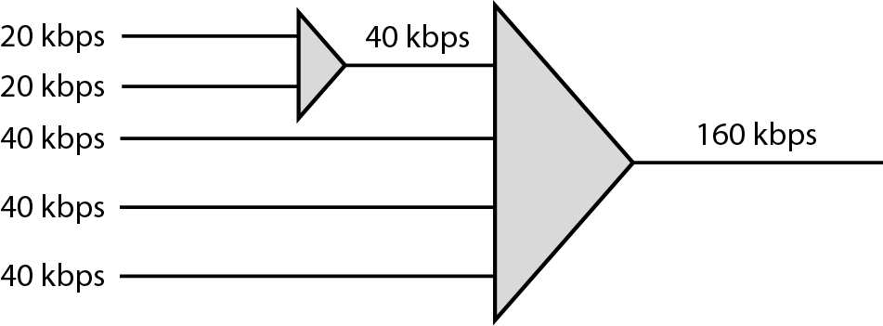
Multilevel multiplexing is a technique used when the data rate of an input line is a multiple of others. For example, here, we have two inputs of 20 kbps and three inputs of 40 kbps. The first two input lines can be multiplexed together to provide a data rate equal to the last three.
A second level of multiplexing can create an output of 160 kbps

Slide 29
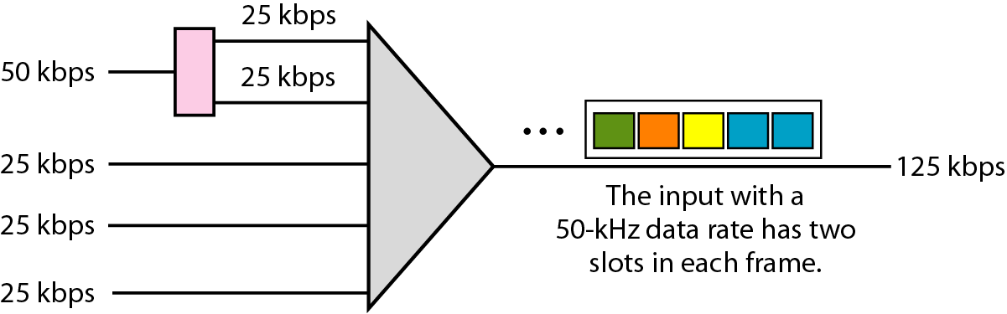
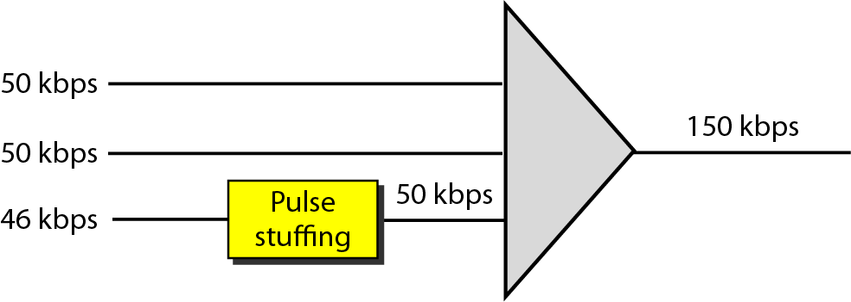
2. Multiple-Slot Allocation: Sometimes it is more efficient to allot more than one slot in a frame to a single input line.
For example, we might have an input line that has a data rate that is a multiple of another input. In Figure, the input line with a 50-kbps data rate can be given two slots in the output. We insert a serial-to-parallel converter in the line to make two inputs out of one.

Slide 30
3. Pulse Stuffing
Sometimes the bit rates of sources are not multiple integers of each other.
Therefore, neither of the above two techniques can be applied.
One solution is to make the highest input data rate the dominant data rate and then add dummy bits to the input lines with lower rates.
This will increase their rates.
This technique is called pulse stuffing, bit padding, or bit stuffing.
The input with a data rate of 46 is pulse-stuffed to increase the rate to 50 kbps.
Now multiplexing can take place.

Slide 31
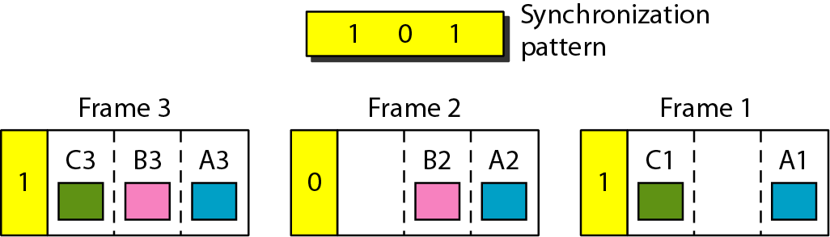
Frame Synchronizing : Synchronization between the multiplexer and de-multiplexer is a major issue. If the multiplexer and the de-multiplexer are not synchronized, a bit belonging to one channel may be received by the wrong channel. For this reason, one or more synchronization bits are usually added to the beginning of each frame. These bits, called framing bits, follow a pattern, frame to frame, that allows the de-multiplexer to synchronize with the incoming stream so that it can separate the time slots accurately. In most cases, this synchronization information consists of 1 bit per frame, alternating between 0 and 1.

Slide 32
Statistical Time-Division Multiplexing
In synchronous TDM, each input has a reserved slot in the output frame. This can be inefficient if some input lines have no data to send.
In statistical TDM, slots are dynamically allocated to improve bandwidth efficiency. Only when an input line has a slot's worth of data to send is it given a slot in the output frame.
In statistical multiplexing, the number of slots in each frame is normally less than the number of input lines.
The multiplexer checks each input line in round- robin fashion; it allocates a slot for an input line if the line has data to send; otherwise, it skips the line and checks the next line.

Slide 33
Statistical Time-Division Multiplexing
Addressing
An output slot in synchronous TDM is totally occupied by data; in statistical TDM, a slot needs to carry data as well as the address of the destination.
In synchronous TDM, there is no need for addressing; synchronization and pre-assigned relationships between the inputs and outputs serve as an address.
In statistical multiplexing, there is no fixed relationship between the inputs and outputs because there are no pre-assigned or reserved slots.
No Synchronization Bit
The frames in statistical TDM need not be synchronized, so we do not need synchronization bits.

Slide 34
Statistical Time-Division Multiplexing
Slot Size
Since a slot carries both data and an address in statistical TDM, the ratio of the data size to address size must be reasonable to make transmission efficient.
For example, it would be inefficient to send 1 bit per slot as data when the address is 3 bits.
In statistical TDM, a block of data is usually many bytes while the address is just a few bytes.

Slide 35
Statistical Time-Division Multiplexing
Bandwidth
In statistical TDM, the capacity of the link is normally less than the sum of the capacities of each channel.
The designers of statistical TDM define the capacity of the link based on the statistics of the load for each channel.
If on average only x percent of the input slots are filled, the capacity of the link reflects this.
Of course, during peak times, some slots need to wait.

Slide 36
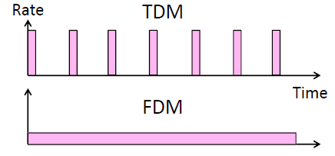
In TDM, a user sends at higher rate a fraction of the time
In FDM, a user sends at low rate all the time

